Slide 1
Online Owner Week Reservations
Save the Date: April 24, 2023

Slide 2
Online OWR
Roll-out Monday, April 24, 2023
  24 Days Away!
Consistent Terminology:
  Quick Book
  Season Search
  Dog-Friendly

Slide 3
FAQs/Talking Points for Owners
Can I still call?
Why did we move to an online system?
Why aren’t Club Points available online?
Can an owner and co-owner both book at the same time?
What is best practice for booking morning?
Can I reschedule my week online?
Will the system be able to handle a busy booking morning?

Slide 4
Owner Communication Schedule and Resources
Added info to owner newsletter- February, March, April
Emailed all affected owners: March 10, March 15, March 22, March 29
Email to all owners without GC logins
Sending physical postcard to Spring/Fall GC8/GL7
Announced on resort Facebook and HOA Facebook pages
Added pop-up to Grand Central
Added info to booking reminders
  Emailing Spring/Fall 3 times

Slide 5
QUIZ!
True or False:
GC8 and GL7 weeks will be available on booking mornings at 9 a.m. MT.

Slide 6
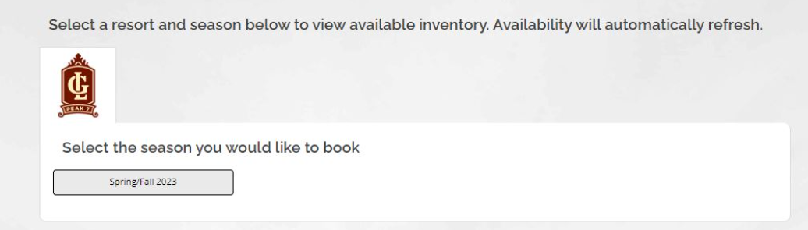
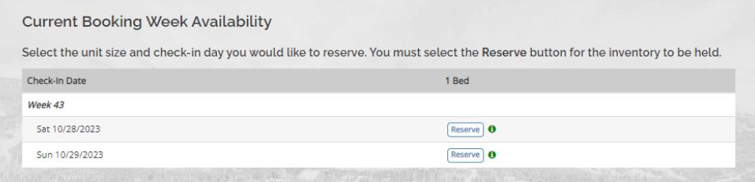
Quick Book
Used for:
GL7 and GC8 booking mornings
How to:
Reservations->Book Owner Week
Select resort and season
Utilize “quick book” section to select current week
All rules are built in
Once you click ‘reserve’ you will have 14 minutes to finalize

Slide 7
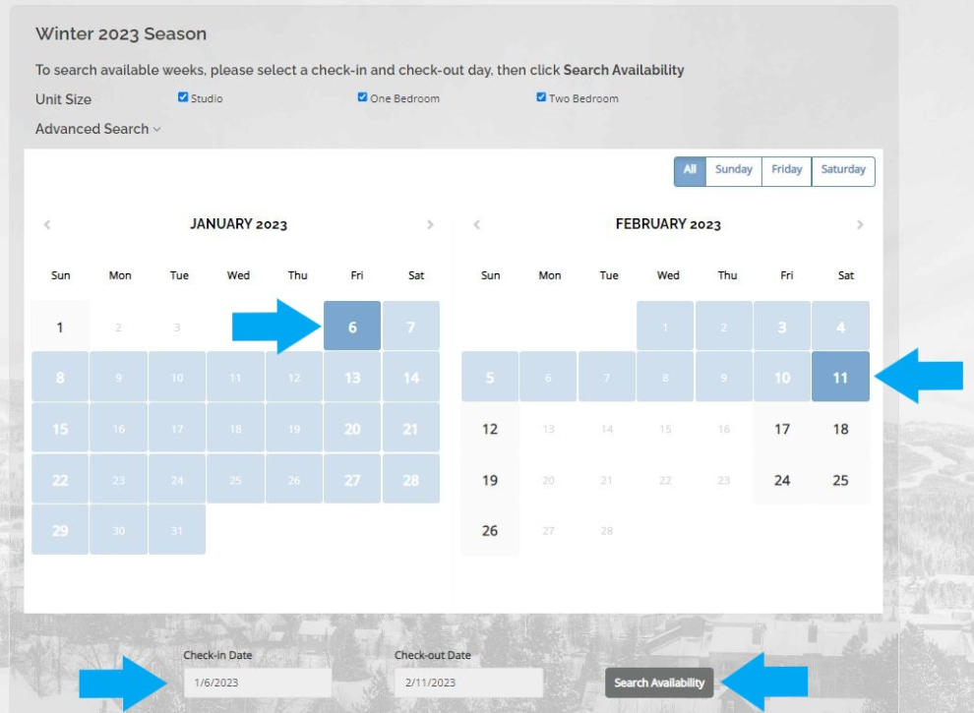
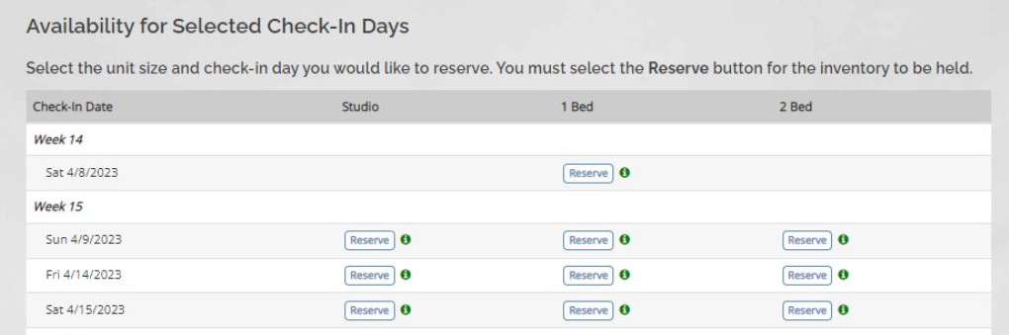
Season Search
Used for:
GL7/GC8 non-booking mornings
Booking morning when week is full
GTL spring/fall
GTL post-ARS
How to:
Reservations->Book Owner Week
Select Season & Year
Select check-in, and check-out and Search Availability
Any/all availability within date range will show
Once you click Reserve, you will have 14 minutes to complete

Slide 8
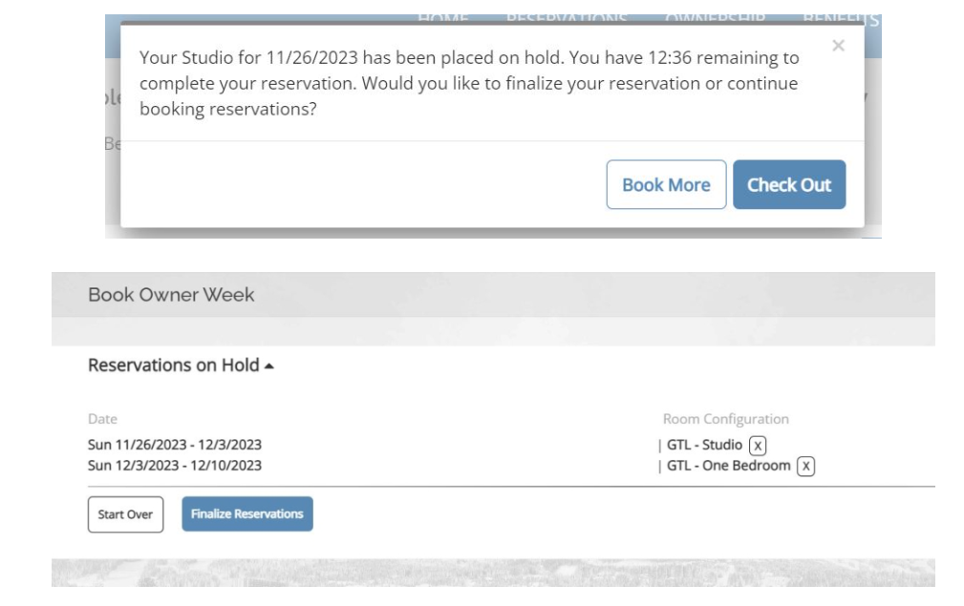
Multiple Reservations
Used for:
Booking multiple reservations in one transaction
How to:
Reservations->Book Owner Week
Select Season & Year
Search availability
Click reserve on first week
When given the option, select Book More
Search availability
Click reserve on second week
Both weeks will be added to your cart for 14 minutes

Slide 9
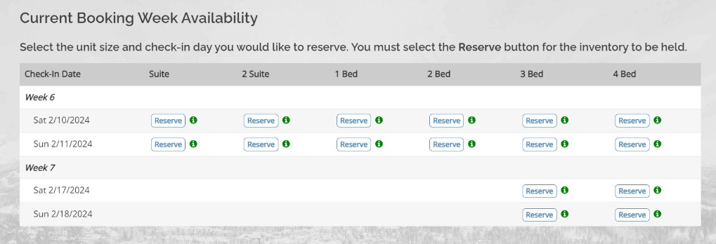
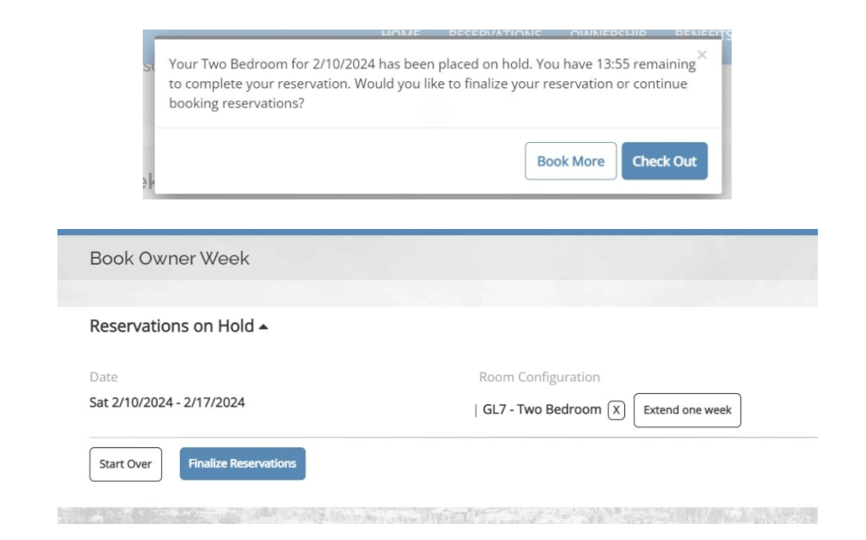
Consecutive Reservations
Used for:
Owners with multiple contracts of the same size unit
How To:
Reservations->Book Owner Week
Select Season & Year
Select week 1 with Quick Book
OWNERS:
  Select book more
  Click EXTEND ONE WEEK
  Finalize both
OWNER RELATIONS:
  Book week 1
  Extend manually in TSW

Slide 10
QUIZ!
True or False:
If an owner books back-to-back weeks, it will be booked as one reservation.

Slide 11
Grand Central Logins
Each owner and co-owner can/should have their own logins
Must be Active (active, future cxl, pipeline) to log in
If owners forget their password:
  They can click Forgot Password on GC login page
  If they call us, send password reset through Owner Profiles
If they know their logins, but want to change password:
  Ownership->Account->Forgot Password tab
  OR cannot see this
If they call on booking morning: Secure their week first, then help with logins

Slide 12
Rescheduling Owner Weeks
Owners can cancel and rebook online, but best practice is to call us
Internal Process:
  Add usage in TSW
  Check availability on GC
  If something is available- book and confirm with owner!
    Cancel previous rez and DO NOT return usage
  If nothing available, advise they still have previous reservation
    Remove added usage in TSW

Slide 13
QUIZ!
When rescheduling an owner week you should:
Cancel first, then search for options in Grand Central
Add usage in TSW, then search in Grand Central (do not cancel rez)

Slide 14
Grand Timber Lodge
GTL Winter and Summer owners will use BiGVARS
  Any owners who do not utilize ARS will use season search AFTER confirmation emails are sent
Spring/Fall 2024 booking day is April 22, 2023
  Spring/Fall owners will call on Saturday to book
  If they do not book on Saturday, they can book online starting Monday, April 24
  Moving forward, Spring/Fall will utilize online OWR season search

Slide 15
BGV ARM: Delinquent Owners
Delinquent owners will be allowed to book on Grand Central
If they have not paid, or set up payment plan, within 1 business day, their week will be cancelled
  Exact internal process TBD
Advisements added to booking process (4x)
Owner must agree to terms of delinquent booking
Will receive additional email stating that they agreed to terms
Note dropped in TSW

Slide 16
QUIZ!
What should owners do for GTL Spring/Fall 2024 booking day?
Book online on Saturday, April 22
Call OR on Saturday, April 22
Wait until Monday and book online

Slide 17
Adding Amenities
Two ways:
During booking process
  Add: High Chair, Dog-Friendly Unit (club only), Pack-n-Play, Request ADA, Rollaway
  Additional requests
Through My Reservations
  Can be added at any point after booking
Drops note into TSW reservation
Sends email to CS inbox

Slide 18
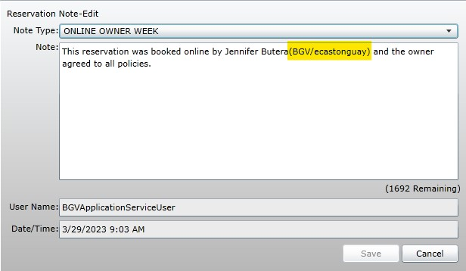
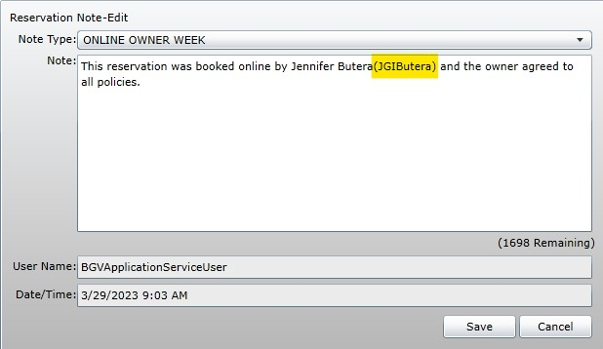
CS Inbox: Auditing Online Owner Weeks
Check: correct contract usage, year, season
If needed, combine consecutive weeks (mirror BT)
  Notes
  Send new confirmation
  Reply with Owner Week Combined template
Rez Prefs
  Booked by owner
  Booked by OR agent
Add Owner Week Audit Note

Slide 19
QUIZ!
Where can you double-check who is responsible for accommodating preferences when an owner week is booked online?
CS Email
Grand Central
Online Owner Week Note

Slide 20
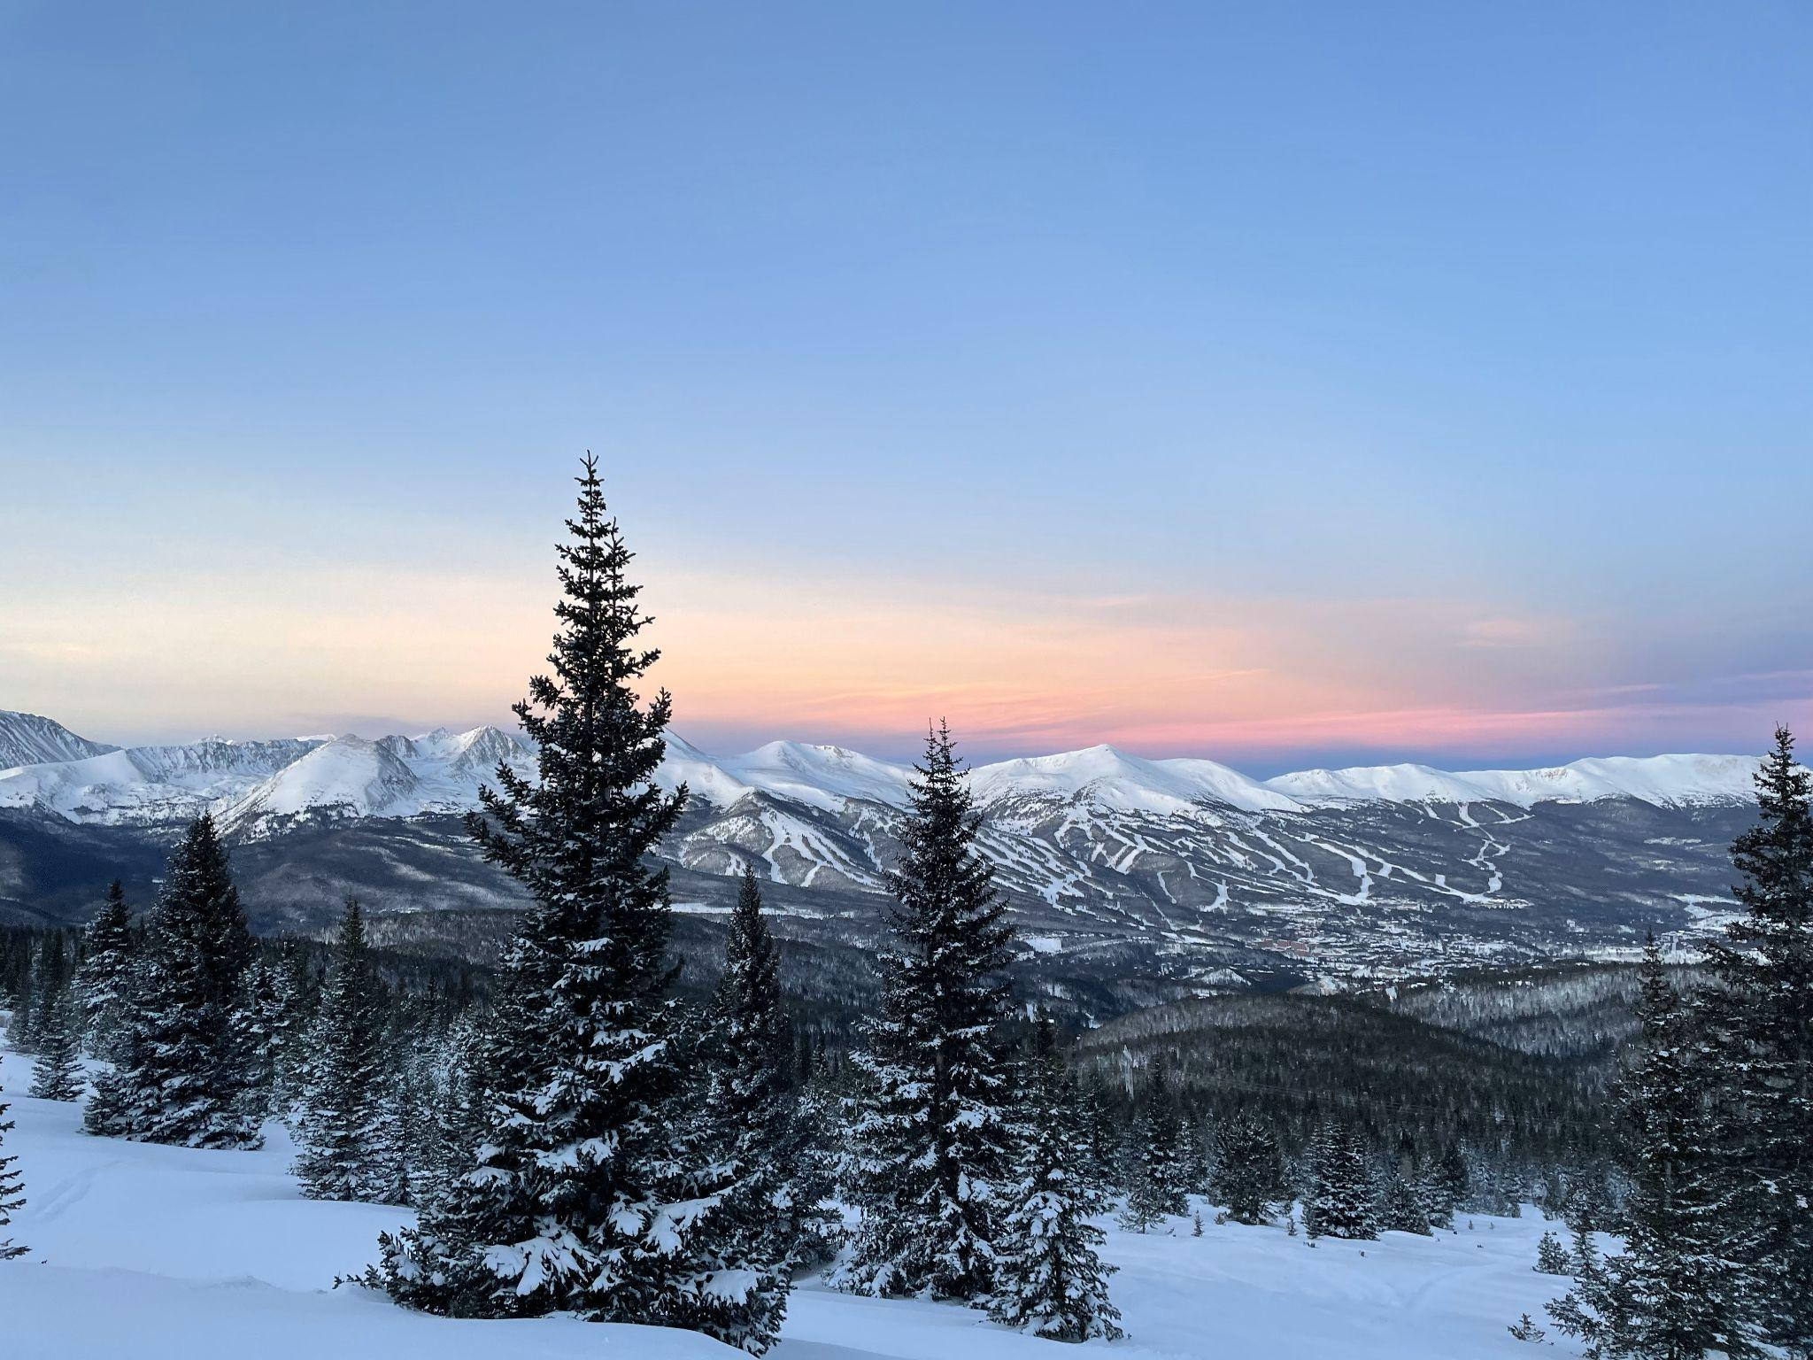

Questions?

